Slide 1
CE/CS/SE 3354 Software Engineering
Lecture 02
More on Software Process Models

Slide 2
Last Class...
What is software
What is software engineering
Why we need software engineering
The waterfall software process model

Slide 3
This Class
More Software Process Models …
The iterative model
The prototype model
Agile development
Pre-course quiz on programming background

Slide 4
The Iterative Model
Solve the risks of waterfall by infinite weak cycles
Requirement Engineering
Design&
Implementation
&Integration
Testing

Slide 5
The Iterative Model
Plan for change
Use the similar steps as waterfall
But expect to iterate the whole process continually, and spend less effort on each iteration (weak cycles)

Slide 6

Example: Ant Project
Building tool for Java (also works for C/C++)
First stable version 1.1 released in June 2000
Small developer group with 3-4 people
First prototype version released in one month
First stable version released in about half a year

Slide 7
Example: Ant Project
The Project evolves for 13 years
5770 issue (bugs & new features) reports from users, 2581 reports handled
7 major versions in 13 years
Code commits 12,000 +
File modifications 50,000 +
Lines of code from 25.6k to 260k

Slide 8
Advantages
Users involve earlier
User can give feedback after the first version released
Cheaper to get a working software
Get the first version very fast
The software always work, though not perfect
Important in many cases, e.g., in competitions
Keep refining requirements, and accommodates changes
Cost for requirement changes/errors are small

Slide 9

Disadvantages
More bugs, sometimes may cause severe loss
420k lines of code, 17 errors
260k lines of code, 5770 bug reports
Design is critical to ensure that a change does not affect the whole system
Ant has 12,000+ code commits

Slide 10
In Practice
Most existing software projects use this model
Daily builds
Releases
Not suitable for systems that are costly for testing or very critical in quality
NASA programs
Military / Scientific / …

Slide 11
This Class
More Software Process Models …
The iterative model
The prototype model
Agile development
Pre-course quiz on Java and android

Slide 12
The Prototype Model
Requirement Engineering
Design&
Build Prototype
Validate Prototype
Formalize
Requirement
Design&
Implementation
Integration

Slide 13
The Prototype Model
Looks like a two-cycle waterfall model
Actually not, it is weak + strong
Different from waterfall
Good: users involve more (by using prototype), reveal small errors in requirements / design
Not solved: still can not handle frequent requirement changes
Bad: prototype is discarded (waste of some effort, sometimes can be even more expensive than waterfall)

Slide 14
When to use prototype model
The desired system needs to have a lot of interaction with the end users
e.g., online systems and GUI applications
Useful for requirement collection
The desired system needs efforts to implement but its effectiveness is uncertain
e.g., novel research ideas
Useful for quick evaluation

Slide 15
Before we go to agile development, let’s see an opinion on time
Time is the enemy of all software projects
Why time matters?

Slide 16
Time matters
The World Changes
Requirement may change
Techniques become obsolete
Computing environment changes
Business Competition

Slide 17
This Class
More Software Process Models …
The iterative model
The prototype model
Agile development
Pre-course survey on programming background

Slide 18
An Agile Method: Extreme Programming
Extreme Programming still uses iterative process model, but goes to extreme

Slide 19
Shorter cycles (2-4 weeks)
Small requirements
Testable user stories
Write tests first (Test-Driven Development, TDD)
Simple design
Simplest design to pass test cases
Pair programming
Code refactoring frequently
Quick evaluation
Have customers involved to evaluate the software frequently

Slide 20
Small Requirements – User Stories

Slide 21
Small Requirements – Test Cases
Customer must describe how the stories are tested
With concrete data examples
Tests should be automated
Test case example
I create an account “account-1”
I ask for list of accounts, I must obtain “account-1”
I create an account “account-1” again, I must get error
I check the balance the account “account-1”, I must get 0
…

Slide 22
Simple Design
Just in time
Design and implement what you know now, not worry too much about future : future is unpredictable
No optimization for future
It is common that the optimization becomes unnecessary
Example: optimization to handle large input data, but later found the input changed (e.g., smaller format, or available in a summarized form)

Slide 23
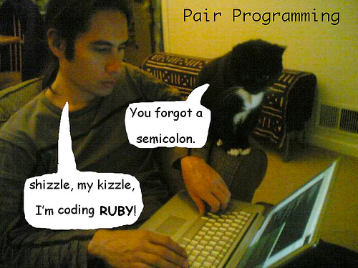
Pair Programming
Programmer and Monitor
Pilot and Copilot
Or Driver and Navigator
Programmer types, monitor think about high-level issues
Disagreement points to design decisions
Pairs are shuffled

Slide 24
Advantages
Results in better code
Instant code review
Monitor always captures the big picture
Results in better developer
More social atmosphere
Instant knowledge/idea exchange
More opportunities to learn new skills and better coding styles
Reduces Risk
More people understands the code

Slide 25
Why people don’t like
Stressful to relate to people all the time
Slows the programming
But save for time in maintenance
Waste of personnel
But less bugs, and more people can work on it, once bugs are revealed

Slide 26
Continuous Testing for Extreme Programming
Always keeps code working
Test before/after any major changes (Continuous testing)
Plan coding to allow frequent tests
Do not do too comprehensive changes, break to phases
Example: Add a product query feature for shopping software
Add list all products first
Add text query
Add filtering conditions one by one
Add sorting
…

Slide 27
A Summary of Extreme Programming
Short cycles
User stories
Test-driven development (TDD)
Pair programming
Continuous testing
...

Slide 28
When to use extreme programming
Requirement prone to change
Easy to get testable requirements (often true in the maintenance phase on a software)
Need quick delivery (business competition)
In practice, frequently used in start-up companies

Slide 29
When not to use extreme programming
Quality critical software (e.g., military, NASA projects)
Large group for large project (still can be used for components)
No highly-involved customers

Slide 30
Next Class
Software Requirements
Concepts
Process
Elicitation
Analysis
Specification
Validation
Elicitation Approaches

